Slide 1





PROJECT
IOT
Presented by Group FPTU HCM

Slide 2





TEAM MEMBER
1st
2nd
3rd
4th
Nguyễn Hoàng Đạt
Nguyễn Thị Ngọc Hân
Nguyễn Thượng Phong
Nguyễn Thế Hiển

Slide 3

ABOUT PROJECT
4 digits 7 Segment
Display Clock

Slide 4



COMPARISON OF TWO VERSIONS
With RTC Version
Without RTC Version
Advantages: High time accuracy, unaffected by power loss.
Disadvantages: Requires additional RTC module, more complex setup.
Advantages: Easy to build, cost-effective.
Disadvantages: Lower time accuracy, susceptible to power loss.

Slide 5
HARDWARE AND TECHNOLOGIES USED
Arduino UNO R3: 1
Breadboard: 1
7 Segment Display: 4
Wire: 55 or more
Resistor 220 Ohm: 5
Pushbutton: 2
LED: 2

Slide 6
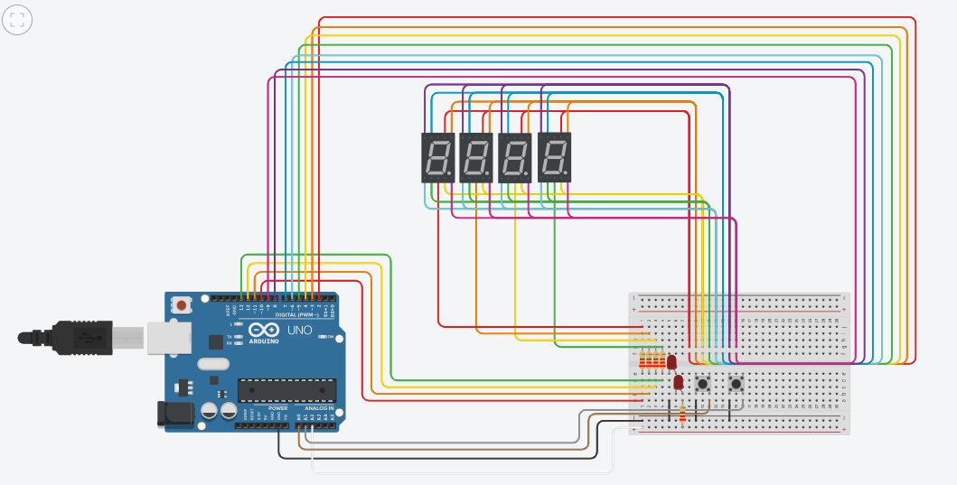

Slide 7
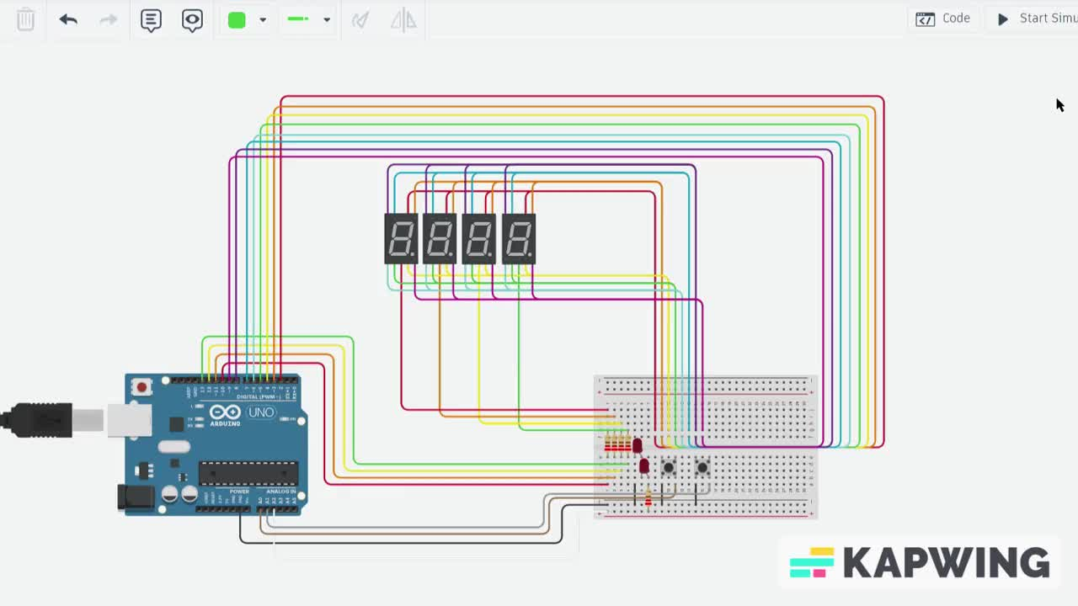

Slide 8
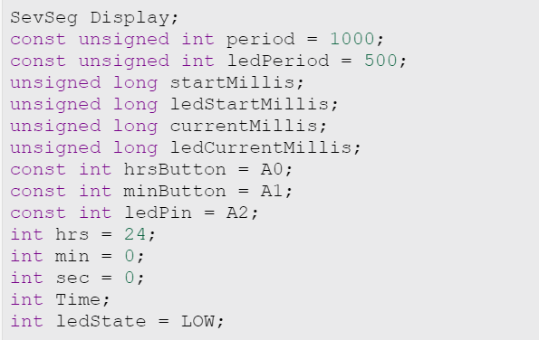
Constants and variables

Slide 9
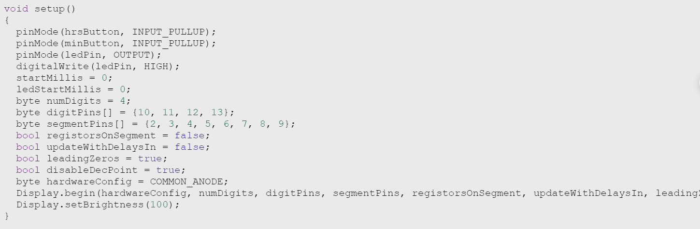
setup()

Slide 10
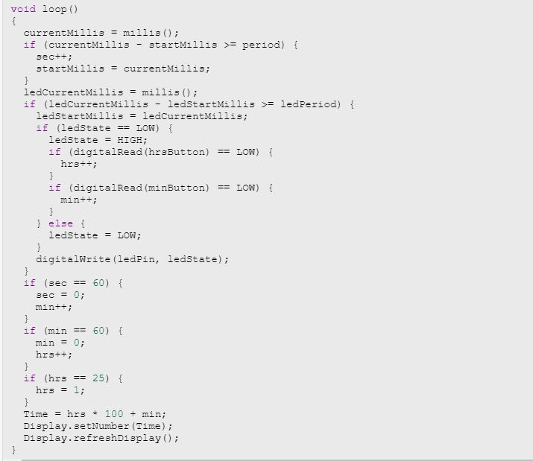
loop()

Slide 11
Hey there, who's got
a burning question
to ask?

Slide 12
A WARM
THANK YOU
TO ALL OF YOU!

